Slide 1

MD. Liton Biswas
Session 2017-18
Department Of Law
University Of Barishal
06-oct-2024

Slide 2


Making Business eCommerce a Reality
Drive transaction cost efficiencies
IT Managers of Fortune 100 companies rank this as among the top five areas to invest in over the next five years
Beta agreements have been signed by three Fortune 100 companies.
Automate financial processes and operations

Slide 3





Go To Market Strategy
Tomorrow
Distributors Sirrius AvNet Support Net
MID-MARKET
INDIRECT
Strategic Partners
50%
IBM ISS
Symantec Tripwire
Independent Software Vendors
F1000
JD Edwards SAP Infinium
50%
DIRECT SALES
$4B Market

Slide 4
Financial Overview
Gross Profit 67%
Net Earnings 78%

Slide 5


Deep understanding of the business model
Be prepared to discuss key assumptions
Revenue analysis – market penetration and timing
Top-down (supportable percentages)
Bottom-up (pipeline, revenue by customers, validation)
l
Expense analysis
Validate with comparable companies, as available
Other (capital equipment, A/R, Inventory & A/P turnover)

Slide 6

Digital Marketing Video

Slide 7
Future Timeline
March 2023
Begin Marketing Efforts for AEDI
March 2024
Elevate marketing of DD to achieve sales goals
August 2025
Begin strategic product development
July 2026
Begin Marketing Efforts for AEDI
July 2028
Close A-round

Slide 8
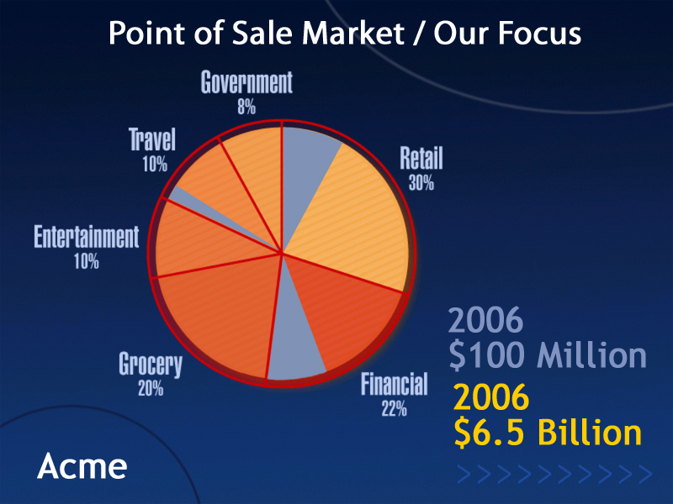

Slide 9

Thank You

